Slide 1
The Hardware Structure of 8086
Chapter 6

Slide 2
In this chapter we will discuss on:
1. Difference between 8086 & 8088
2. Pin functions of 8086 in minimum & maximum modes
3. use of address latches & data buffers in an 8086 based system
4. concept of machine cycles and the associated bus timings of 8086
5. reason for using the bus controller IC in a maximum mode system
6. How an 8086 is used in the maximum mode?
7. To calculate instruction timing & thus create delay loops
Earlier we have dealt exclusively with the programming aspect of 8086, now we will see for hardware aspects of the processor.

Slide 3
Pin Configuration
Lets see the processor in terms of its hardware that includes:
Pin configuration
Functions of the pins
memory bus cycles
connections to other chips
modes of operations
The first PC was built with 8088 processor & most ways similar to 8086

Slide 4
Difference Between 8088 & 8086
8088 has an external data bus of 8 bits, while 8086 has a 16-bit data bus
Instruction queue of 8088 is 4 bytes, while 8086 has a 16-byte queue
for 8088, pin no.28 (minimum mode) is an M / IO pin, while for 8086, the pin is M/IO
Pin no. 34 is SSO for 8088, while it is BHE / S7 for 8086

Slide 5
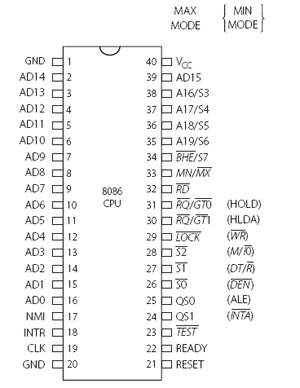
8088 & 8086 CPU pin diagram
8088 Pin
8086 Pin

Slide 6
Pin diagrams of both processor are shown
Both processors are packaged as 40-pin DIP (dual-in-line package) .
Some pins are dual functions corresponds to minimum & maximum modes
Minimum mode –when used in uni-processor configuration
Maximum mode –when used in multi-processor configuration
Here we will discuss the hardware aspects of 8086
It is the basic processor in the X86 family

Slide 7
Minimum Mode Pins in 8086

Slide 8
pins 24 to 31 have are seen to have dual functions
functions in bracket indicate the pin designation to be in the minimum mode for those pins
for min mode operation, pin no.33 MN/MX should be at logic high
we know that 8086 has a 16-bit data bus & 20-bit address bus
Lets locate the address & data pins in the pin diagram
We can see a set of 16 pins designated as AD, i.e AD0 – AD15
They are address/data pins
Notation ‘AD’ means that these pins are used for address as well as data
They are multiplexed for data & address, such that at a particular time they carry address & at other time s they carry data

Slide 9
Reason for multiplexing is to reduce the number of pins of the chip
8086 has only 40 pin counts
As the data bus & address bus have to be separate & because the ‘address’ has to be available at all times
the address-data lines have to be de-multiplexed means separated
this can be done by the use of latches
availing the timing features of bus cycles

Slide 10
De-Multiplexing the Address/ Data Bus
The action of separating address and data is called
de-multiplexing
lets see that, memory is to be read from or written to
W.K.T there are some steps involved for reading & writing memory
first step in reading memory is ‘placing the address on the address bus’
This is the 1st part of the bus cycle
Next, to appear data on the data bus, means the bus must be made free to carry data
for de-multiplexing, during the time that the address is in the address/data bus, it is to be latched on to a ‘Latch IC’ whose clock is ALE(Address latch enable) signal supplied to 8086
Signal ALE goes high & functions as a clock for a latch that is used to save the address value, as the address has to be available throughout the bus cycle
Once the address is latched on to the latches, it can be removed from the AD lines, then these lines are free to carry data.

Slide 11
This action is only for 16 address lines
But 8086 has 20-bit address
So, in pin diagram, pin numbers 35 to 38 also used for address
They are A16 to A19
They are also multiplexed with status signals
Diagram for address/data de-multiplexing

Slide 12
De-Multiplexed Address Bus
We know what is de-multiplexing?
To make sure that address is available on the memory or I/O address throught the complete read/write bus cycle
with 20 lines of address information & line BHE have to be latched & output of latch will constitute the address bus.
So, 21 lines are to be latched with the help of external ICs
One very popular latch IC is the 3 state octal transparent latch 74LS373
As one IC have only to 8 lines, 3 such latches are needed for de-multiplexing
Pin diagram shows how IC appears
The data sheet of this IC specifies that, all the 8 latches of this 74LS373 is D-type latch
Means that while enable (G) is HIGH, the Q outputs will follow the D-inputs.

Slide 13
Here ALE is connected to the G pin of the IC
The OC (output control) is grounded for normal operation.

Slide 14
De-Multiplexing Data Bus

Slide 15
Control signals for Read & Write
Before going to discussion on bus timings
we should know about the associated control signals RD , WR, M/IO may also be buffered
as the output signals are sent out by 8086
these lines are unidirectional
hence the buffer IC74LS244 is sufficient to use.
This is a unidirectional tri-state octal buffer

Slide 16
Memory and I / O
Signals RD, WR, M/IO have to be used suitably to get the memory read/write
as MEMRD and MEMWR and the I/O read/write signals IORD and IOWR
the circuit diagram shows the I/O and Memory having seprate lines for access.

Slide 17
Clock Generation
One cycle of the clock is called a T state, and all timings and delays are multiples of this T state duration.
8086 to have a clock signal
There is no circuitry inside the processor for
this, and so an external clock generator IC is used.
Intel has provided the clock generator IC 8284A which is compatible with 8086 / 8088.
This generates based on the crystal connected between two of its terminal
crystal frequency should be 3 times the desired frequency for the microprocessor
so 8086 operates at frequencies of 5 to 15 MHz
We see the basic functions associated with minimum modes systems

Slide 18
Pin configuration of the clock generator 8284A

Slide 19
Clock generator IC
The clock generator IC performs a few more functions than just supplying the clock frequency to the processor.
The crystal is connected between the X1 and X2 pins.
The READY output pin of 8284A is connected to the READY input pin of 8086.
This pin is used to overcome the timing inconsistencies that are possible when a slow peripheral / memory device is connected to the processor.
Extra wait states are inserted when READY signal is low.

Slide 20
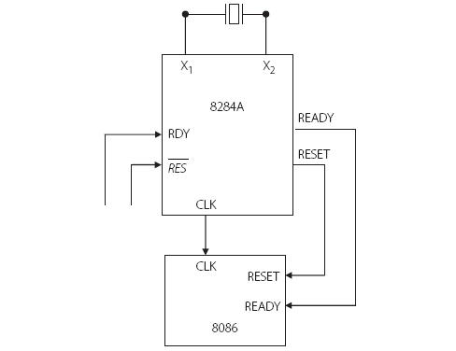
Connections of the clock generator IC to 8086

Slide 21
Reset
An active low reset signal from the control bus is sent to the 8284 which synchronizes it with the trailing edge of the clock.
Most systems include a line that goes to all system components and possibly controlled by an operator push button (or just after power on), which causes a low signal on the RESET pin of the clock generator.

Slide 22
Reset Timings and reset vector
The RESET line of 8086 must remain high for at least 4 clock periods.
The 8086 will terminate operations on the high-going edge of RESET and will remain dormant as long as RESET is HIGH.
A high on the RESET pin of the processor causes all system components to be reset, and inside it, the instruction queue, PSW, DS, SS, ES and IP are cleared.
CS gets a value of FFFFH and with IP = 0000, the first instruction will be executed from the location FFFF0H.

Slide 23
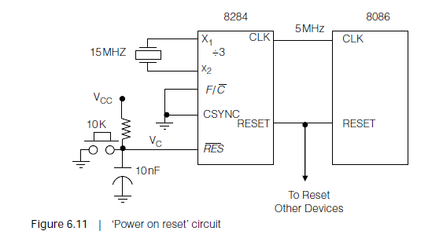
Power on reset
When power is switched on, the 8086 should be RESET.
This is called power on reset

Slide 24
Clock
All activities on the system bus are synchronized by the system clock
that provides the basic timing
Activities of the Bus are:
1. Reading from memory I/O
2. Writing to memory I/O
Any read or write cycle is called a bus cycle.
For 8086, a bus cycle takes 4 T states, where one T state is defined as the ‘period’ of the clock.
If the clock frequency is 10 MHz, one T state = 0.1 usecs or 100 nsecs.
A bus cycle is also called a machine cycle.
During a machine cycle, a specific operation – say, reading or writing is accomplished.

Slide 25
Typical machine cycles
Memory Read
Memory Write
I / O Read
I / O Write
Interrupt Acknowledge

Slide 26
Read Machine Cycle
Place on the address bus, the address of the location whose content is to be read. This action is performed by the processor.
Assert the read control signal which is part of the control bus.
Wait until the content of the addressed location appears on the data bus.
Transfer the data on the data bus to the processor.
De-activate the read control signal. The read operation is over and the address on the address bus is not relevant anymore.

Slide 27
Read machine cycle timing diagram

Slide 28
Many control signals are needed in the machine cycle, that are shown in diagram
According to the previous diagram,
Which is relevant for both ‘memory read’ & ‘I/O read’
here time is marked along the horizontal direction
the activities of the pins of 8086 at corresponding points are shown
some of the lines are single signals like, ALE, RD, WR etc.
others are group of signals like the address bus & data bus
M/IO is a single line which has one of two possible states in a machine cycle

Slide 29
Wait Cycles
If the access time for a device is longer than that permitted by 8086 timing, extra clock cycles termed ‘wait states’ have to be inserted in the bus cycle.
Sample the READY line at the end of T₂. If the READY signal is found low, an extra T state is inserted into the bus cycle, between T₃ and T₄ , which is designated as T_{W} .
All signals on the bus remain unchanged during this extra wait state (T_{W}).
In the middle of T_{W} , once again the READY signal is checked. If it is at logic 1, the next T state will be T₄ – otherwise another wait state T_{W} will be inserted.

Slide 30
Sampling the READY signal and inserting wait states

Slide 31
What is the duration of the bus-cycle in an 8086 based microcomputer, if the clock frequency is 12 MHz and three wait states are inserted?

Slide 32
The period of a 12 MHz microprocessor is T = 1 / f = 83 ns.
Thus, the duration of the bus-cycle, without any wait-states is given by;
T_{bus-cycles} = 4* T = 4* 83 ns = 332 ns.
Duration of the wait-states is, T_{w} = 3* T = 249 ns.
So the extended bus-cycle T_{bus-cycle}+ T_{w} = 332 + 249
= 581 ns.

Slide 33
Other Processor Activities
Interrupt Lines
DMA
TEST
BHE
HALT Machine cycle

Slide 34
Interrupt Lines
As word “Interrupt” implies that is being done is to be temporarily stalled as to take up another activity.
Same in case of processor too
During performance of any activity by the processor
Any external device ask for attention by placing a signal on an ‘interrupt request’ line
processor stops whatever is doing and attends to the request of the interrupting device
As soon as its gets an interrupt request on the INTR line, it responds by lowering the INTA and enters an interrupt acknowledge machine cycle
NMI is another line on which external device can place an interrupt request
difference is INTA sends ack, but NMI doesn’t.

Slide 35
DIRECT MEMORY ACCESS(DMA)
Till now we have seen processor communicating with memory or I/O
Is it possible to send data in memory to I/O or vice versa with out involving the processor?
DMA is the method of transferring data between the memory and a peripheral without involving the processor.
During the time of DMA, the buses of the processor are tri-stated.
The pins HOLD and HLDA are devoted to DMA operation.

Slide 36
Concept of DMA

Slide 37
At this point, what is to be understood is, the DMA controller places a DMA request on the HOLD pin of 8086
in order to take permission for control of the system bus
As DMA is of high priority service, the processor stops whatever is doing and ACK the request by raising HLDA line & DMA is initiated

Slide 38
TEST and BHE pins
Both these pins are active low
The TEST pin is used to synchronize the activities of the 8086 with an arithmetic co-processor 8087 (Detail in chap 13)
The BHE (Bus High Enable) is used to enable high bank of memory (Detail in chap 7)

Slide 39
Halt Machine Cycle
Another machine cycle is the HALT machine cycle. The processor enters this machine cycle in response to a HLT (Halt) instruction.
To bring the processor out of this state, an interrupt or a RESET signal must be issued

Slide 40
8086 in the minimum mode configuration

Slide 41
Maximum Mode
In this mode, which is used for multi processing (inter-process communication) ,the processor needs a lot more pins.
Some pin designations are changed .
Most of the important control functions are not obtained from the processor
but will have to be generated from an external chip bus controller IC 8288.
INTA, ALE, DT/R, M/IO & WR are to be generated externally.

Slide 42
Maximum mode pins of 8086

Slide 43
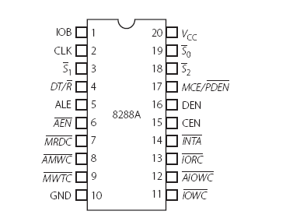
Bus Controller
In maximum mode configuration, pin nos. 26, 27 & 28 are designated as S0 , S1 and S2.
Using these pins, the 8086 outputs a code that specifies the type of bus cycle to be initiated

Slide 44
corresponding machine cycles & the important control signal initiated by8288 are show

Slide 45
Connection diagram between 8086 & 8288

Slide 46
REQUEST/GRANT pins
These are two bi-directional ,active low pins ,on which other processors in a multi processing system can place their bus requests.
Time associated with the RQ/GT pin

Slide 47
Queue Status pins QS0 , QS1
These pins are inputs to the 8086.
It becomes useful when an arithmetic coprocessor is the second processor in the system.
Since the co-processor is expected to work in step with 8086, the co-processor can interrogate the 8086 about its queue status, on these lines, and decide its course of action accordingly.
More details are given in Chapter 13.

Slide 48
The LOCK signal
The active low LOCK signal can be used to prevent other bus masters from acquiring the bus of the 8086.
For example, if the 8086 wants to retain the bus until a string transfer is completed fully, it can use the instruction (say) LOCK REP MOVSB.
So the processor does not have to relinquish the bus after one bus cycle, as may be the case if the LOCK prefix is not used.
Instead, the bus is retained until the complete string operation is over.

Slide 49
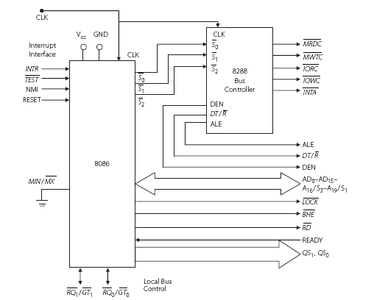
Maximum mode configuration of the 8086

Slide 50
Instruction Cycle
The time taken by the processor to execute an instruction is called an instruction cycle, and it is specified in terms of the number of clock cycles needed to do it.
The operation of the CPU is just ‘fetch, decode and execute’.
Once an instruction is fetched and is ready for execution, it will be decoded immediately, and after that, execution can be set in motion.

Slide 51
FETCH –EXECUTE CYCLE
The fetch-execute cycle can be decomposed into 6 stages
FI – Fetch instruction
DI – Decode instruction
CO – Calculate operand addresses
FO – Fetch operands
EI – Execute instruction
WO – Write or store result in memory
The time for all these activities should constitute the ‘instruction cycle’.
Because of pre-fetching ,the fetch time is usually not a part of the instruction cycle
But calculation of the effective address does take time.

Slide 52
Execution Times of Some Sample Instructions

Slide 53
Number of Cycles Expended in Calculating the ‘Effective Address

Slide 54
Delay Loops
MOV CX, 100 ;4 cycles
HERE: LOOP HERE ;17 / 5 cycles
Delay cycles: 4 + (17 × 100) −12 = 1692 cycles
For a system with 12 MHz, one clock period is 0.083 usecs
Total delay =140 usecs

Slide 55


Write a program to create a delay of 1 msec

Slide 56
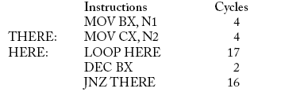
Write a delay loop with appropriate values of the count to get a delay of 1 second.
The inner loop is that which corresponds to the LOOP instruction. It repeats N2 times, which is the count in the CX register.
The LOOP instruction plus a few overheads (caused by the instructions MOV CX, N2 and DEC BX) repeat N1 times, which is the count of the outer loop.

Slide 57
Why Delay Loops?
Generating delays in this manner is called ‘software delay’. One can generate a square wave using a software delay.
Delay loops can also be used to generate events spaced in time.

